Slide 1
Generative Deep Learning
2026 Fall
조상구교수

Slide 2
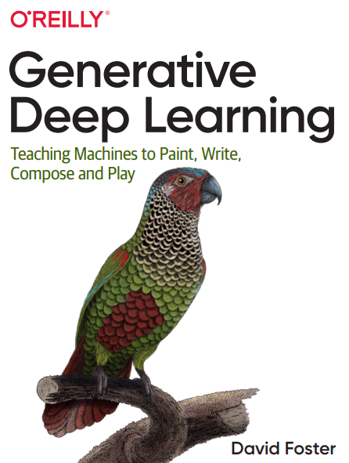
Goals
Chapter 01 Generative Deep Learning
Chapter 03 Variational Autoencoders
Chapter 04 Generative Adversarial Networks

